Slide 1
Digital Portfolio
STUDENT NAME: Sampreeta SV
REGISTER NO AND NMID: 2428c0509 and 75847B66F0D4C5283F94C10368CF4BA0
DEPARTMENT: II B.Sc AIML
COLLEGE: COLLEGE/ UNIVERSITY:KPR College of Arts Science and Research

Slide 2
PROJECT TITLE
AI & ML based digital portfolio with Social Entrepreneur

Slide 3


AGENDA
Problem Statement
Project Overview
End Users
Tools and Technologies
Portfolio design and Layout
Features and Functionality
Results and Screenshots
Conclusion
Github Link
3/21/2024 Annual Review

Slide 4

PROBLEM STATEMENT
In rural and underserved communities, access to quality education, timely healthcare, and sustainable livelihood opportunities remains a major challenge. Conventional solutions are often expensive, resource-heavy, and difficult to scale. There is a pressing need for affordable, technology-driven interventions that leverage Artificial Intelligence and Machine Learning (AIML) to create personalized, inclusive, and impactful solutions for social good.

Slide 5

PROJECT OVERVIEW
Many rural and underprivileged communities still lack access to quality education, healthcare, and resources. Traditional solutions are often costly and not scalable. There is a need for AI/ML-based approaches that are affordable, adaptable, and impactful to solve these real-world social challenges.

Slide 6

WHO ARE THE END USERS?
Students in rural and semi-urban schools.
Teachers and educators
Smallholder farmers
Community health workers & patients
Non-Governmental Organizations (NGOs)
.

Slide 7

TOOLS AND TECHNIQUES
Languages: Python, JavaScript, HTML/CSS
AI/ML: TensorFlow, PyTorch, Scikit-Learn, OpenCV
Data: Pandas, NumPy, SQL
Deployment: Flask, Streamlit
Techniques: NLP, Computer Vision, Recommendation Systems, Transfer Learning

Slide 8
POTFOLIO DESIGN AND LAYOUT
Dark theme with neon gradient highlights
2.Sections: About Me, AIML Projects, Achievements, Contact
3.Interactive UI with 3D cards and glassmorphism
8

Slide 9
FEATURES AND FUNCTIONALITY
About Me: Introduction as a Social Entrepreneur & AIML Student
Portfolio Sections: About, AIML Projects, Achievements, Contact
AI & ML Projects: Smart Tutoring, CropCare, MediAssist Chatbot
Interactive Design: Dark theme, gradient highlights, 3D effects & user-friendly
navigation

Slide 10
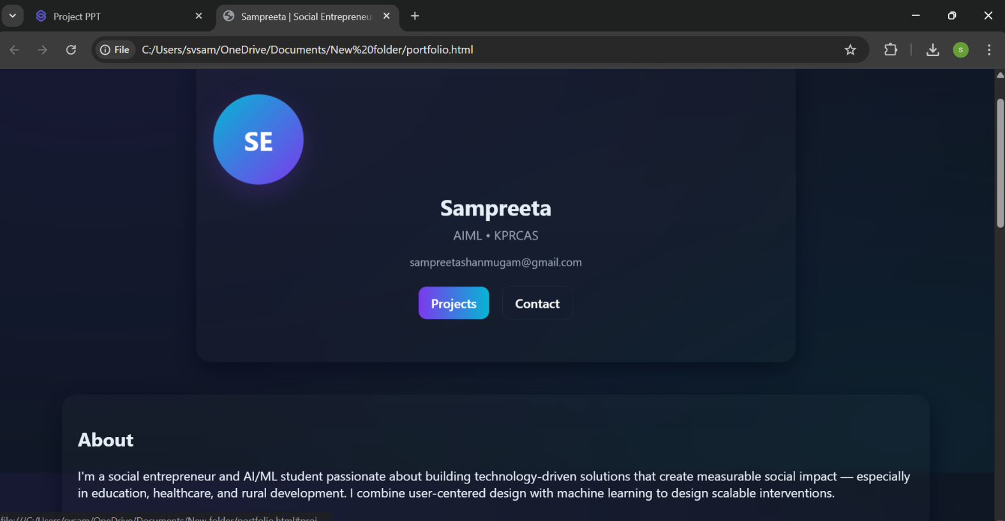

RESULTS AND SCREENSHOTS
Created a stylish interactive portfolio website with 3D effects
Showcased AIML projects (Smart Tutoring, Crop Care, Medi Assist)
Highlighted achievements and real-world social impact
Integrated user-friendly design with dark theme & gradients
3/21/2024 Annual Review
10

Slide 11
CONCLUSION
i. This portfolio highlights how a social entrepreneur and AIML student can combine innovation with social impact to solve real-world problems.
ii. It serves as more than a project showcase — it represents a commitment to using technology for community development and future career opportunities.
11

Slide 12
GITHUB LINK PORTFOLIO REPOSITORY: https://github.com/sampreetashanmugam06-design/Sampreeta.git

